Slide 1
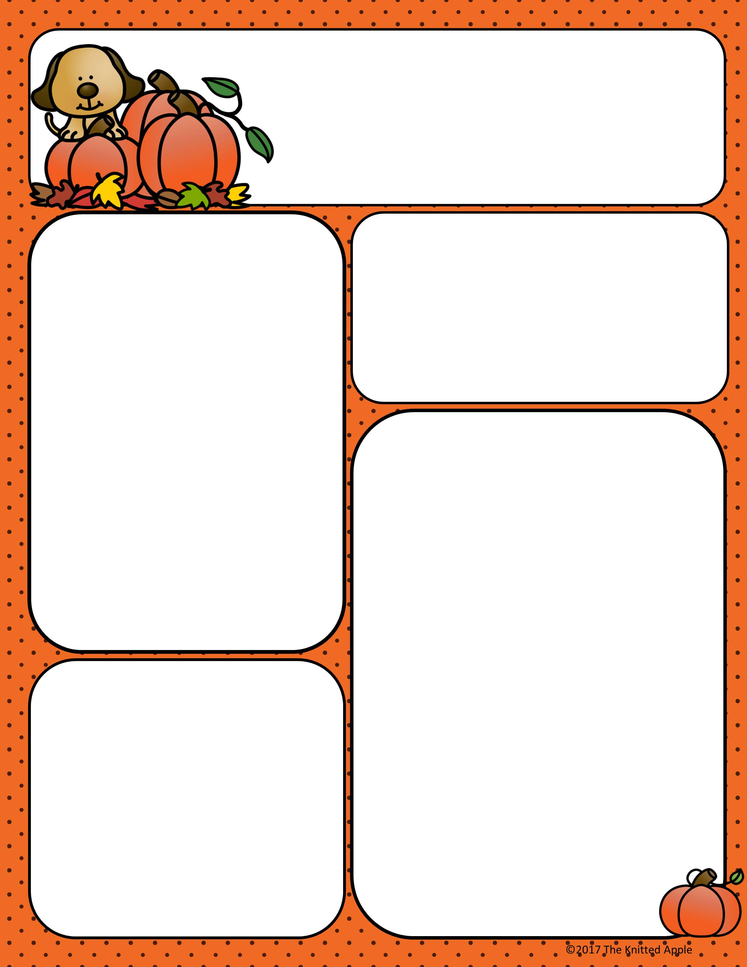
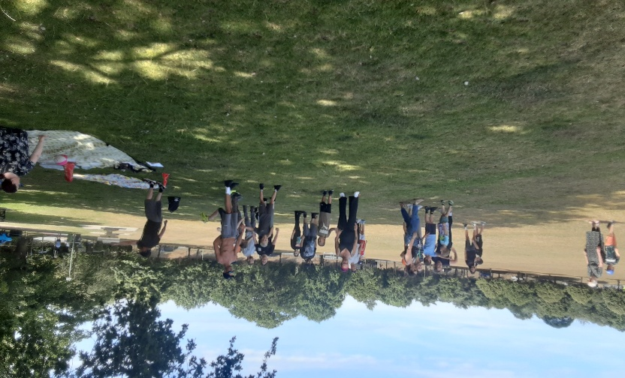
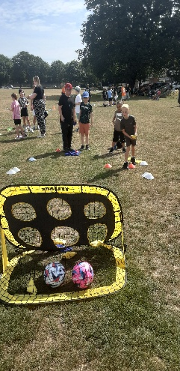
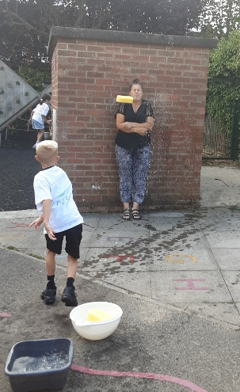
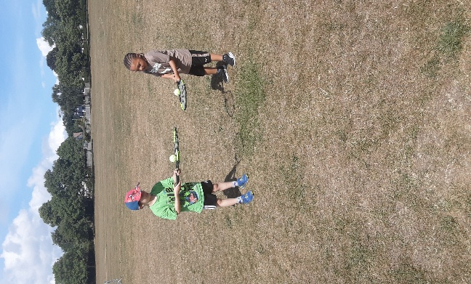
Autumn Term 2025
Lowestoft
Curriculum News
Upcoming Events/ Resource
This academic year we have invested in read write inc (literacy) and Numicon (maths) please see the links on our website for parent guides.
Next half term, our exciting topic in Key Stage 1 will be 'All About Me'. We’ll be exploring what makes each of us unique, with a focus on humans and our senses in Science. In Geography and History, we’ll learn about our local area and its past, while in PSHE, we'll be thinking about our own identities, feelings, and how we relate to others.
Next half term, our topic in Key Stage 2 will be 'We Are Britain'. Pupils will explore the countries of the UK, learn about significant British historical heroes, and create traditional dishes in Design and Technology. In Science, we'll focus on nutrition, the skeleton, and muscles, while in PSHE, children will be learning all about money and how to manage it.
Emergency services day – 9th September
World food day – 16th October
Odd Socks day – 10th November
Children in need – 14th November
Holiday Activity and Food (HAF) In Suffolk
https://infolink.suffolk.gov.uk/kb5/suffolk/infolink/advice.page?id=Zj4vWQtEbvA&fbclid=IwAR2Q-ViD3G9lcEW0fCrJBnplRopFNwbpjOnpgaHkvNr6a2UReu8Gq0Q0Ruw
Magic Moments
For more photos, please see our website.
Important dates
Autumn term 2025:
Starts: Monday 1st September 2025
Half term: Monday 27th October 2025 to Friday 31st October 2025
Ends: Friday 19th December 2025
Christmas: Saturday 2oth December 2025 to Monday 5th January 2026
PD Days: Monday 1st September,
Tuesday 2nd September,
For a list of all Term and PD dates please see our website:
https://www.includesuffolk.org.uk/

